Slide 1

Tip Generator using fuzzy logic

Slide 2
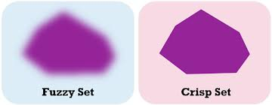
Content
Aim
Introduction to Fuzzy sets
Architecture
Fuzzification
Defuzzification
Code demo
Image source: https://images.app.goo.gl/YxFP2guB5Ez2iPnD7

Slide 3
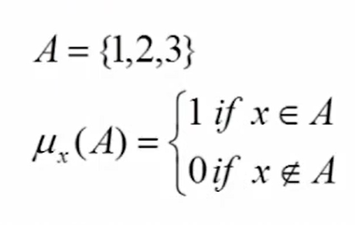
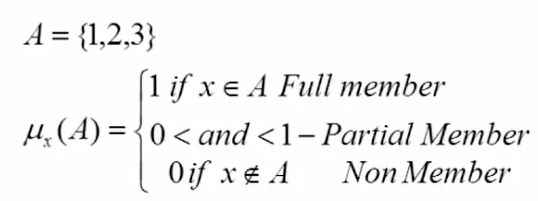
Introduction to Fuzzy Sets
Aim: To build a tip generator system based on fuzzy logic.
The membership function of the crisp set returns binary value i.e either 1 or 0.
The membership function of fuzzy set returns values in the interval [0,1].
Fig 3.1. Crisp set
Fig 3.2. Fuzzy set
Image source: https://youtu.be/7f8OhirnRvo
Notes:
The aim of the project is to build a tip generator system based on fuzzy logic. The word “fuzzy” means vagueness or ambiguity. Fuzziness occurs when the boundary of a piece of information is not clear-cut. The sets are we are familiar with are called crisp sets. The membership of the crisp set returns binary value i.e either 1 or 0. For example (mention image 1). Whereas fuzzy sets provide membership to an element in intervals between zero and one inclusively. So the values zero and one and all the values that lie between zero and for example say 0.1 or 0.67 and so on. For example(image 2) if a member belongs to a set, its membership value is 1, otherwise it is 0. Meanwhile, with fuzzy set theory permits membership function valued in the interval [0,1]. An element can be a partial member of a set in fuzzy set theory.

Slide 4
Architecture
INPUT
OUTPUT
FUZZIFICATION
FUZZIFY INFERENCE SYSTEM
DEFUZZIFICATION
FUZZY SETS
RULE BASE
Fig 4.1. Architecture
Notes:
So let us assume that you went to a restaurant and you want to decide how much tip you have to give to that restaurant. So we can do that using the fuzzy system. Let us consider that the tip generated will depend on two factors i.e quality of food and service provided by the restaurant. Explain figure.

Slide 5
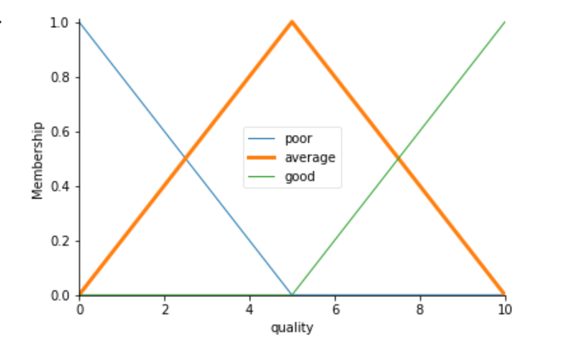
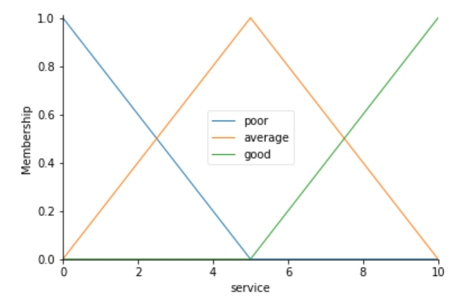
Fuzzification
Fig 5.1. Membership function graph for quality
Fig 5.2. Membership function graph for service
Notes:
So we will be giving a rating out of 10 for quality and service. So as you can see in the graph the x axis is nothing but the scale range which goes from 0 to 10. And the y axis is the fuzzy range value from 0 to 1. To get the fuzzified value, we need to have an intersection point. The lines present in the graph are called membership functions and respective y values are membership values. The region under the line is called as fuzzy region. Here we consider triangular membership functions. For example, trapezoidal function, L function, Gaussian function are used to create an intersection for given inputs. Here we are using triangular membership functions.

Slide 6
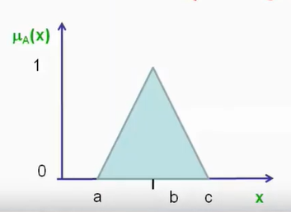
Triangulation membership function
Triangular membership function
triangle(x: a, b, c) =
0 x<a
(x-a)/(b-a) a<=x<=b
(c-x)/(c-b) b<=x<=c
0 x>c
Fig 6.1. Graphical representation of triangular membership function
Image source: https://youtu.be/d5Hpktx6NLA
Notes:
Let’s try to understand the triangular membership function. It is specified mathematically by 3 values a, b, c, where a and c are the extremities of the triangle and b, is the midpoint or the point corresponding to the peak of the triangle. So we can change the values of a, b and c to control the shape of the triangle. So this represents that x is less than a then its going to be zero. If the value of x is between a & b then the slope is going to be x-a/b-a. Similarly, if the value of x lies between b & c then the slope is going to be c-x/c-b. And if value of x is greater than c then its out of the bounds of this triangular function.

Slide 7
Fuzzification
Fig 7.1. Membership function graph for quality
Fig 7.2. Membership function graph for service
Notes:
Since we have 3 fuzzy regions we can write a fuzzy set with 3 values. For example for quality, the fuzzy set is ={poor, average, good}, similarly, for service, the fuzzy set is ={poor, average, good} and for the tip, we have a fuzzy set = {low, medium, high}. So we are taking 3 fuzzy membership functions and from that, we are getting 3 fuzzy regions. Now we need to get our fuzzified values. Let us assume we give 6.5 for quality and 9.8 for service. We extend these points until they intersect with the lines. So for quality, we see that it intersects with average and good. So to get the fuzzified values we extend the intersection points to the y axis. Therefore for the quality, we get 2 fuzzified values that are 0.6 and 0.4 for average and good respectively. Similarly, after extending the points for service we get 2 values that are 0.2 and 0.8 for average and good respectively. Therefore we get 4 fuzzified values.

Slide 8
Fuzzy Inference Engine
Rule Base
Rule 1 – If Quality = poor & Service = poor then Tip = poor.
Rule 2 – If Quality = average & Service = average then Tip = medium.
Rule 2 – If Quality = good & Service = good then Tip = high.
Fig 8.1. Membership function graph for quality
Fig 7.2. Membership function graph for service
Notes:
So after the fuzzification process, the next is our fuzzy inference engine. For this, we need 3 things – fuzzy set as input, rule base as well as the fuzzified values which we got in the fuzzification process. Now what is exactly the rule base, so whenever you are tackling a problem related to fuzzy you need to have your own rule base. We have mentioned 3 rule bases in our project, first rule is if the quality is poor and the service is poor then the tip is low. The second rule is if the quality is average and service is average then the tip is medium. The third rule is if the quality is good and the service is good then the tip is high. We have already mentioned our fuzzy sets for quality, service and tip along with the 4 intersected fuzzified values. All these 3 things will be given to the fuzzy inference engine. The inference system will map our rule base with the fuzzified values. Before moving forward, the lines on which the points intersect are called as firing strength. For example, in quality, we have firing strength for average and good region but we do not have it for poor region since there is no intersection. Therefore we discard rule 1. For rule 2, since quality is average and service is average, we get 2 values like 0.6 and 0.2. For rule 3, since quality is good and service is good, we get 2 values like 0.4 and 0.8. Now since there is an “and” operator, we choose the minimum value of the two values, i.e for rule 2 we take 0.2 and for rule 3 we take 0.4

Slide 9
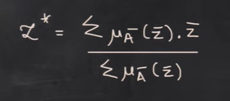
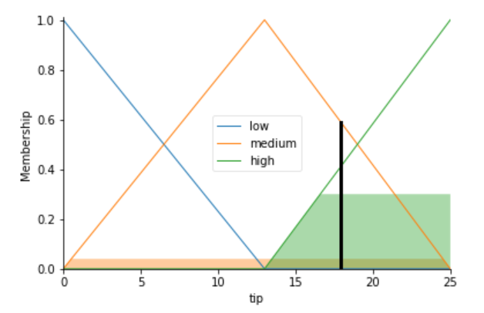
Defuzzification
Fig 9.1 Formula for weighted average function
Image source: https://youtu.be/OPB9uZgHZ30
Applying the formula we get,
= 0.4 x 17 + 0.2 x 22
0.4 + 0.2
Fig 9.1 Graphical representation for the tip
= 18.66666 %
Notes:
So we map the values 0.2 for medium tip and 0.4 for high tip. So we have got the intersection points now we have to map them to its respective tip x value. But now we need to give a single percentage value to give the tip. So this value is computed through the method of defuzzification. We have various methods of defuzzification like lambda cut, weighted average etc. Here we will be using weighted average for defuzzification. The formula for weighted average is as shown on the right side, which represents that the sum of the membership values multiplied by its corresponding point divided by the sum of the membership values . Therefore applying the formula we get (read the equation). So we get 18%, it can be one percent up or down but the range will be same since we have mapped it with our hand. But when we code it we get the accurate percentage.

Slide 10
CODE DEMONSTRATION

Slide 11


